Slide 1


RT NETWORK SOLUTIONS PVT. LTD.
AN ISO 9001 – 2015 CERTIFIED COMPANY

Slide 2




About Us
RT NETWORK SOLUTIONS PVT LTD is an IT Enabled Services company with the vision to be a successful service enterprise which encourages leadership and commands the admiration of our customers and employees. We offer various types of roll out services and data digitization services across various technical domains.
The core philosophy at RTNS is to meet customer requirements accurately within exacting deadlines. Committed to this belief, we offer you the best industry standards and dependable support.
Our work has been highly appreciated by a number of large and small clients, both international and national, in various industries for exceptional performance and quality services in the fields of Networking, Telecommunications , Applications, IT Security, GIS, Customer Service & Data Digitization.

Slide 3
What we do
In today’s business environment, distinguishing yourself from your competition is paramount. Be it by appealing to individual attitudes, lifestyle or desires, it is all about effective communication that uses the combination and uniqueness of different media to deliver impact. Described below are our main areas of focus and expertise.
Network , Telecom ,GIS , Physical Survey, Application & Data Digitization
At RTNS, we specialize in procurement of satellite image (authorized dealer of Planet), Creation of base map, Physical survey with GPS, DGPS, Door to door Survey, mapping, designing and installing vsat/LL networks , Microwave Networks , IP Based Router Networks , In-Building WiFi networks across diverse locations. We are the Authorized Service Providers of HCL , Bharti Airtel, Wipro , Hughes Communications, Tata Net , HP, SIFY Technologies , Reliance Jio, CISCO, TCS and other System Integrators for installing and maintaining the Networks and Applications at their various customer premises across various parts of India.
We have implemented major projects for all these clients in East and North-East states.
We have been part of Planet.com. From where we provide 5mt to 72cm high resolution map in daily basis.
We had implement RAPDRP Asset survey where we create base map, HT & LT Networking, DTR Survey, Door to door consumer meter survey and finally upload this data to client survey through ARCFm platform. We did this for 26 towns of West Bengal

Slide 4
What we do
We had implement RAPDRP Asset survey maintained for 26 towns where we update existing network in daily basis .
We did Relaince Jio Fiber Optical Networking and made ABD drawing for West Bengal & Jharkhand.
We did GIS Survey for identification of shortest route for laying of Optical Fiber Network for BBNL with WBSEDCL Govt. of WB
Providing skilled Manpower to HCL for Uttar Pradesh & Haryana RAPDRP.
Providing skilled Manpower for TCS North-East RAPDRP.
Providing skilled Manpower for Relaince Jio GIS Department.
Working with Torrent Power GIS Mapping Project.
Working with Torrent GAS GIS Mapping Project.

Slide 5

What we do
We serve customers in the
following segments:
Corporate
Government
Defense
Banking & Finance.
Terrestrial Networks
We integrate LL/ISDN networks for data and voice connectivity. We take care of end to end connectivity - supplying, commissioning , router configuration , application testing and integration with other Networks
IT Security & Application Roll Out
Our team of networking , application and security specialists are experienced in implementing large scale desktop application roll out, security roll out and anti virus roll out projects for major clients.
We also provide Facility Management Services by placing FM engineers at the client’s premises to cater to the IT needs of the client on-site. We have over 500 FM engineers placed at various customer premises

Slide 6



What we do
Geomatics Services
We offer a full spectrum of GIS/RS services and solutions, ranging from Spatial Data Mapping & Analysis to Document management /archiving & Physical Survey. Our Credential encompasses around satisfying esteemed clients with solution varying from Utility/Facility/Social Mapping, Web GIS Based MIS generation Suitable Site Selection, Problem Area Identification to Data Archiving and retrieval.
Data Conversion
Scanning / Digitizing / Vectorization.
Cartographic & Map Layout Generation.
E-Book Creation.
Data Entry and Tabulation.
Image Conversion through OCR.(Optical Character recognition)
Data Management.
Geo-database creation & Management.
Document Management System (DMS).
Database Update service.

Slide 7


What we do
Image Processing
Seamless data creation.
Resolution Improvement & Merging/ Noise Reduction.
Cloud removal / Geo-positioning.
Image Fitting.
Change Detection from multi-temporal imagery.
Retrieving old brittle maps.
Image cleaning and Editing.
Remote Sensing & GIS based Solution
Land use / Land cover Mapping
Vector updates (Transport Network Mapping).
High-resolution Urban Mapping.
Forest Density Mapping.
Water turbidity mapping.
Crop Pattern and Crop Health Mapping.
Utility Mapping / Multi-Level.

Slide 8


What we do
Digital Marketing
Digital marketing is perhaps the best way to promote your business and take it to the next level at the present moment. With digital marketing, you can get access to clients quite easily and worldwide.
At RT Network Solutions Pvt. Ltd. we have a team of efficient and competent digital marketers who can deliver the kind of result you want. They will help you to convert the traffic to actual sales. That is why RT Network Solutions has a huge number of contented clients.
24/7 CUSTOMER SERVICE GUARANTEED
WE CREATE BRAND STORIES THAT MAKES EVERYONE HAPPY

Slide 9







What we do
Digital Marketing
Search Engine Optimization (SEO)
Social Media Marketing (SMM)
PPC Campaign
Website Design & Development
eCommerce Design & Development
WordPress, Magento 2, Shopify Development

Slide 10
Our Strengths
Experience of Manpower & Roll Out Services
All engineers of RTNS have vast experience and exposure in installing and maintaining vsat networks and terrestrial networks as well as Application development. Apart from the field force that we have to support vsat and terrestrial networks, we have a huge pool of engineers across various pockets in most of the states of India who are well trained to take up major Government projects of Data Entry, Bio Metrics and Data Digitization.
Experience in Project Management
All Program Managers have dealt with live projects and have experience in delivering projects on time. Projects are implemented under the supervision of an experienced Program Manager, who plans and interacts with the clients.
Cisco /HPN/ Microsoft Experience
All our field engineers have basic knowledge of Cisco routers & HPN Routers (configuration and 1st level trouble shooting) and Microsoft Products in Windows PC’s. Experienced and senior engineers are deployed for high end jobs. We have implemented large number of sites in SBI roll Out through Cisco Routers and a large number of sites in DOP Roll Out with HPN routers.
Application Experience
We also do Application integration in various networks. Experienced in Video, voice and Data applications. Data applications include stock trading, ATM, SCADA , ERP, etc. RF planning and network optimization are also undertaken. We undertake SAP roll Outs and Oracle roll outs at different customer premises as well.

Slide 11


Our Strengths
Network Audit
RTNS engineers are experienced in using audit tools likes Sniffer and analyzing the data to solve critical problems.
Engineers have worked on visibility products like Smart Manage, which give a complete insight into a network generating graphical charts representing Network Utilization, Application Utilization, TCP/IP sessions etc.
Customer Relations
We are well known for our Technical execution skills and organisational attitude. We believe in long term relation with customers and contribute to our customers through continuous value addition

Slide 12

Our Reach
Head office is at Kolkata
We have Area Offices at the following locations :
Bhubaneshwar | Sambalpur | Behrampore | Balasore
Ranchi | Dhanbad | Jamshedpur | Muzaffarpur
Patna | Siliguri | Guwahati | Tinsukia
Agartala | Imphal | Itanagar | Silchar
Kharagpur | Bankura | Bangalore | Lucknow
Raipur | Jaipur | Mumbai | Delhi
We have a manpower strength of over 1000 resources spread across the geography of India.

Slide 13
Process/Systems
Call Tracking
A dedicated Program Manager who will act as the single window from RTNS to the client will track all requests and incidents logged with RTNS till closure .
Escalation Matrix
A clear escalation matrix will be handed over to ensure quality service.
Help Line
A 24x7 help line number will be provided to ensure support even at odd hours.

Slide 14
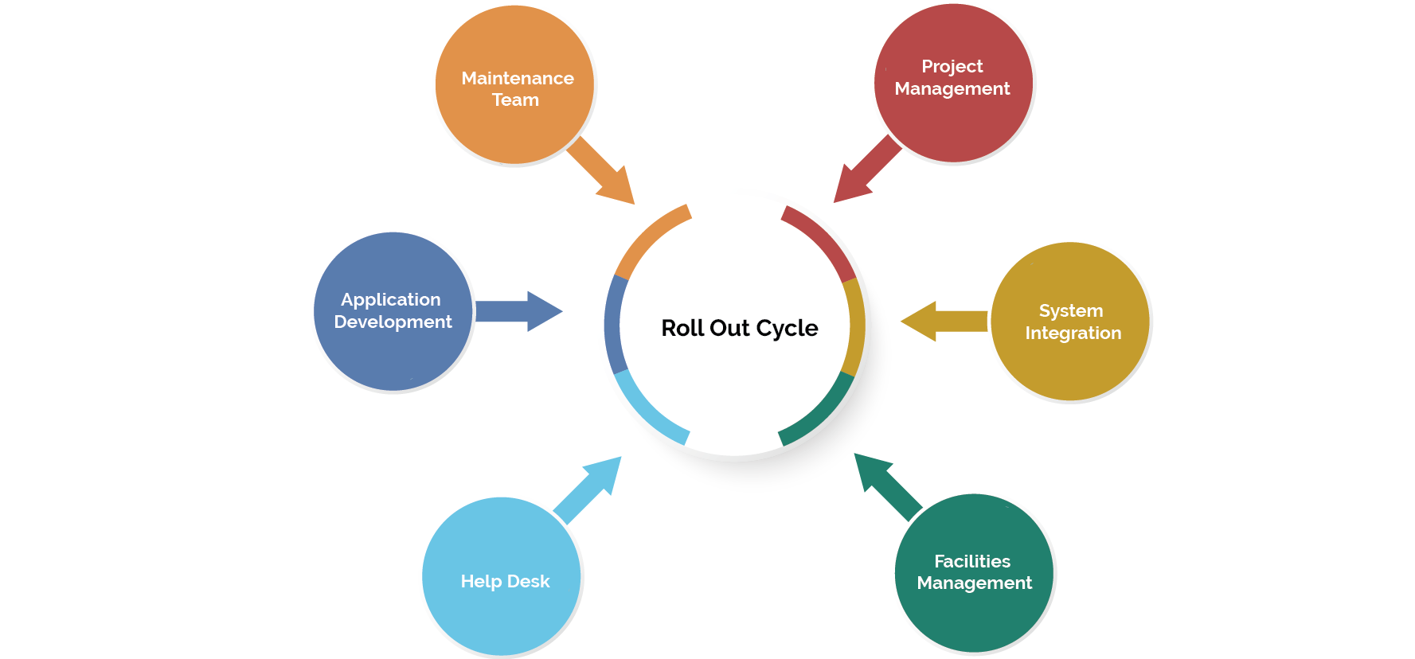
Our Support Chart

Slide 15
Major Projects
CISCO router integration for Reliance Jio and Airtel
Microwave installations for Reliance Jio
IBS & College Wifi implementation with Reliance Jio
FSA wise FTTx implementation with Reliance Jio
Providing invigilators to TCS iON for conducting various online examinations
Documents digitization project at Patna High Court
Digitization of Service Books for DoP
Implementation and Maintenance of Meter Data Acquisition System for NE APDRP project along with TCS.
Implementation and Maintenance of MDAS for WB R-APDRP project along with TCS.
GIS Survey (DGPS) and Mapping in the Satellite Map for WBSEDCL along with TCS.
Creation of GIS Base Map through Satellite Image Interpretation.
NPR ( National Population Register ) Project
SECC ( Socio Economic Caste Census ) Project
DoP ( Network Rollout of Post Offices ) along with SIFY Technologies
Rollout of SBI MS Project along with Hughes Communication
Rollout of UBI Banking Project along with HCL
Rollout of NE VAT Project across NE along with Bharti Airtel
Arunachal Pradesh SWAN Project along with HCL
Wide Area Network for Indian Army along with HCL and Bharti Airtel Ltd.
GIS Survey for identification of shortest route for laying of Optical Fiber Network for BBNL with WBSEDCL Govt. of WB
GIS Survey for ABD Mapping for Reliance JIO.

Slide 16













Some Major Clients

Slide 17
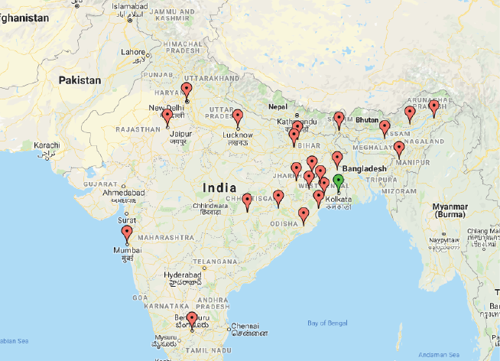
We Are Located At :
RT Network Solutions Pvt. Ltd.
Eco Centre, Suit No. 0614,
Block EM, Plot No. 4,
Sector V, Salt Lake City,
Kolkata-700091.
Martin Burn Business Park, 17th Floor,
BP Block, Sector V, 3, Kolkata,
West Bengal 700091

